Slide 1
Software Partnership Meeting
On Prior Art Resources
Thursday, December 5, 2013
1:00PM – 4:30PM
Madison North Auditorium Alexandria, VA

Slide 2
Software Partnership Meeting
On Prior Art Resources
James Dwyer
Assistant Deputy Commissioner for Patent Operations
James.Dwyer@uspto.gov

Slide 3
Software Partnership Meeting
On Prior Art Resources
Margaret A. (Peggy) Focarino
Commissioner for Patents

Slide 4
Prior Art Resources
Seema S. Rao
Technology Center Group Director, TC 2100
Seema.Rao@uspto.gov
(571) 272-5253

Slide 5
Agenda
Time | Topic
10 minutes | Introduction & Background
70 minutes | USPTO Presentations Brian Sircus Scott Beliveau Pamela Reynolds Boris Pesin Q & A
15 minutes | Break
70 minutes | Stakeholder Presentations Brad Pederson (Patterson Thuente IP) John Toebes (Cisco Systems) Dominic DeMarco (DeMarco IP, LLC and PIUG) Michael Messinger (Sterne, Kessler, Goldstein, and Fox) Q & A
30 minutes | Open Discussion
5 minutes | Closing Remarks

Slide 6
Federal Register Notice on Software Partnership 78 Fed. Reg. 292 (Jan. 2013)
Topic: topics for the future software partnership meetings
Comment: prior-art-based searching during examination of software and computer implemented inventions

Slide 7
Federal Register Notice on Software Partnership 78 Fed. Reg. 292 (Jan. 2013)
Enable examiners to search academic papers, books, brochures, and other publications provided by outside companies
Private sector provision of/access to prior art resources
Maximize benefit of 3rd-party submissions

Slide 8
Agency Approach
Educate stakeholders on USPTO search resources and techniques
Listen to external stakeholders’ views
Work with stakeholders to improve searching

Slide 9
Public Resources
http://www.uspto.gov/products/library/ptdl/
Seven Step Strategy is a basic search tutorial which can be divided into three sections
Formulating a search strategy including
Classification search
Keywords
Tools and databases
Evaluation process
Notes:
You will see the theme through out our presentations this afternoon.

Slide 10
USPTO Presentations
Search Strategies and Tools
Collaboration Resources
Scientific and Technical Information Center (STIC)
Search Demonstration

Slide 11
Search Strategies and Tools
Brian Sircus
Quality Assurance Specialist (QAS), TC 2800

Slide 12
Patent Training Academy (PTA)
Entry Level Program
IP Experienced Program
New examiners without IP experience
Initial 4-month training in PTA
In-depth training on U.S. statutes, rules, procedures, and practices
Automation tools (OACS, eDAN, EAST, WEST, etc.)
Claim interpretation through lectures, exercises, and mentoring
Lab exercises
Hands-on walkthrough of patent examining process with discipline-specific training application
Just-in-time training throughout the first year
New examiners with experience in IP
Initial 25-day training in PTA
Brief overview of U.S. statutes, rules, procedures, and practices
Automation tools (OACS, eDAN, EAST, WEST, etc.)
Claim interpretation through lectures, exercises, and mentoring
Just-in-time training throughout the first year

Slide 13
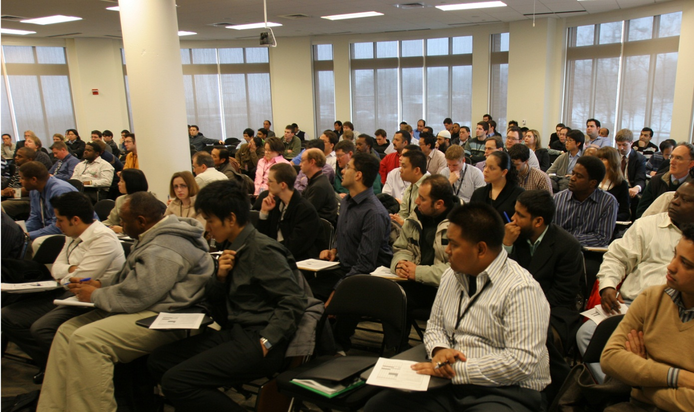
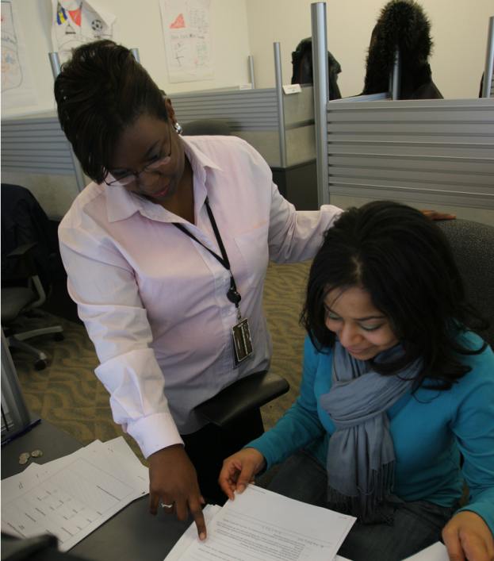
PTA

Slide 14
MPEP 904 – How to Search
Locate the most pertinent art ASAP
“It is rare that a text search alone will constitute a thorough search of patent documents.” (MPEP 904.02)
Prioritize areas most likely to produce relevant art
Record search in OACS “Search Notes” form

Slide 15
Seven-Step Search Strategy
Identify Classes
Brainstorm keywords related to purpose, use, and composition
Look up the keywords in the Index to the U.S. Patent Classification and CPC to find classes/subclasses
Verify the relevance of the classes/subclasses by using the Classification Schedule in the Manual of Classification
Read the Classification Definitions to verify the scope of the subclasses and note “see also” references
Access Full Text
Search the Patent and PGPub databases by Current U.S. or CPC Classification
Review
Review claims, specification, and drawings of references for relevance
Check references’ “U.S. Cl.” and “Field of Search” areas for additional class/subclasses

Slide 16
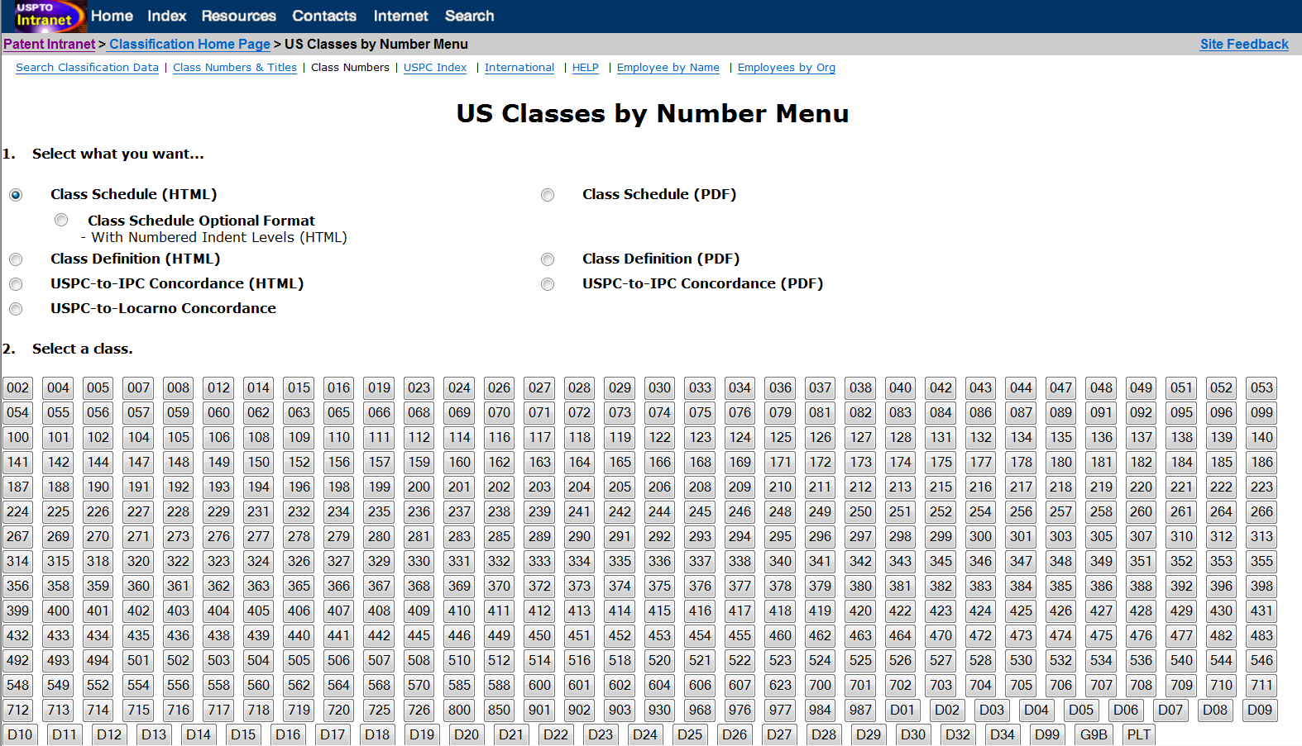
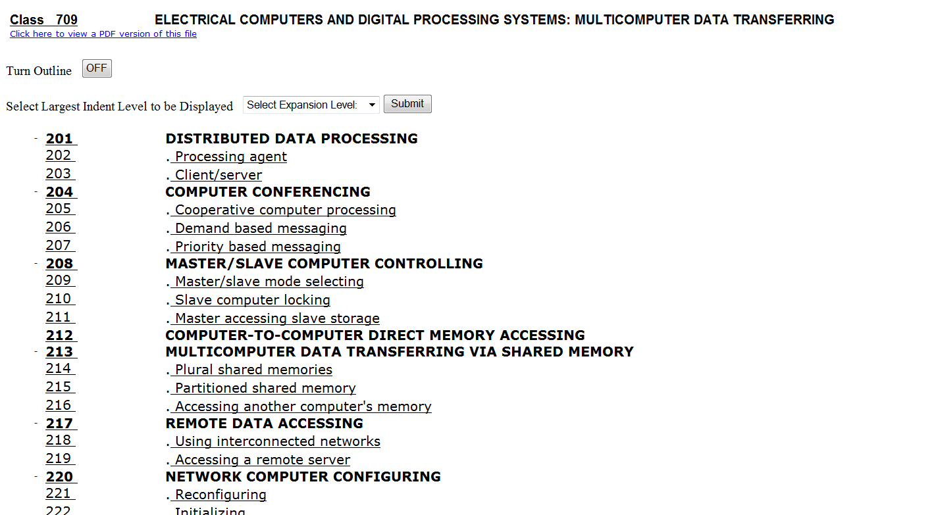
USPC

Slide 17
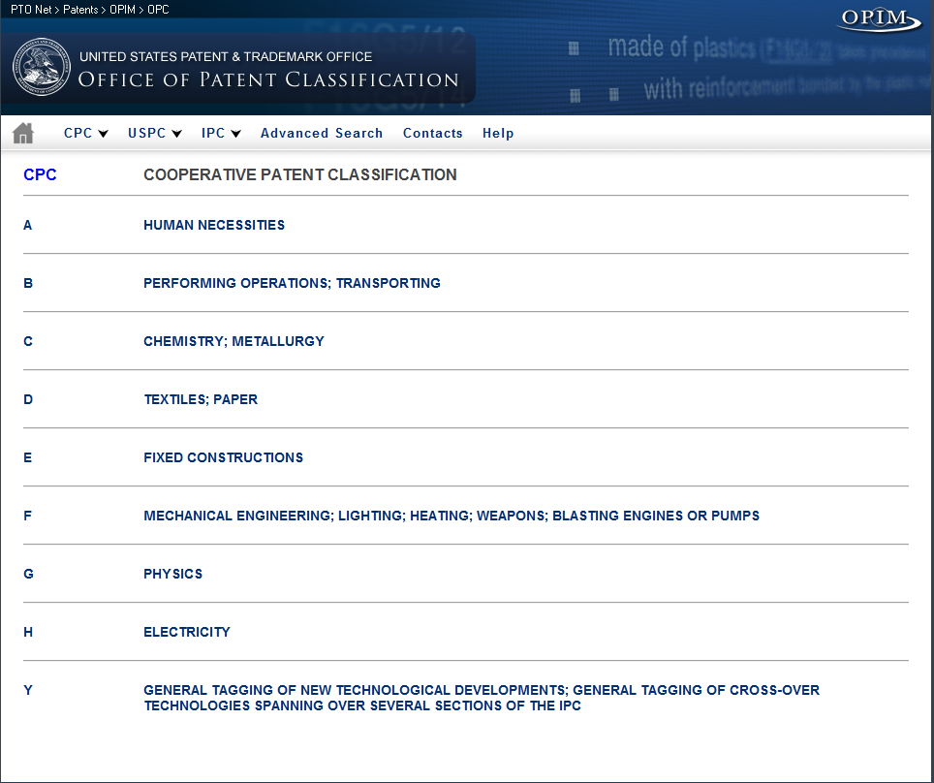
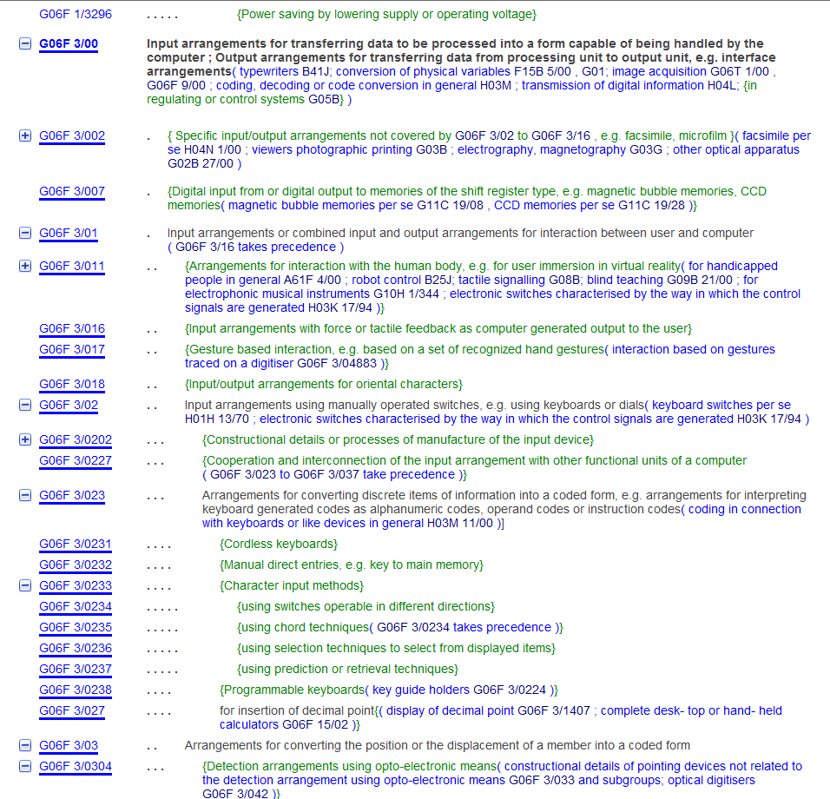
CPC

Slide 18
Tools
EAST
Examiner's Automated Search Tool
WEST
Web Examiner Search Tool
Notes:
Both EAST and West are the search tools that an examiner can use to search an application. Both of these search systems have the capability to allow an examiner to perform a classification search using either USPC or CPC (NOTE – currently the USPTO is shifting to using the CPC)

Slide 19
Patent-Related Databases
US Patents Full-Text
US Pre-Grant Publication Full-Text
EPO Abstracts
JPO Abstracts
Derwent World Patents Index
IBM Technical Disclosure Bulletin
US Patents OCR Backfile
Notes:
Both EAST and WEST allow an examiner to search the same Databases.

Slide 20
Search Capabilities
Patent/PGPub numbers
Classification
U.S. Patent Classification (USPC)
Cooperative Patent Classification (CPC)
International Patent Classification (IPC)
Text searching
Boolean and proximity operators
Applying truncation to search terms
Inventor or assignee
Forward and backward citations
Date ranges

Slide 21
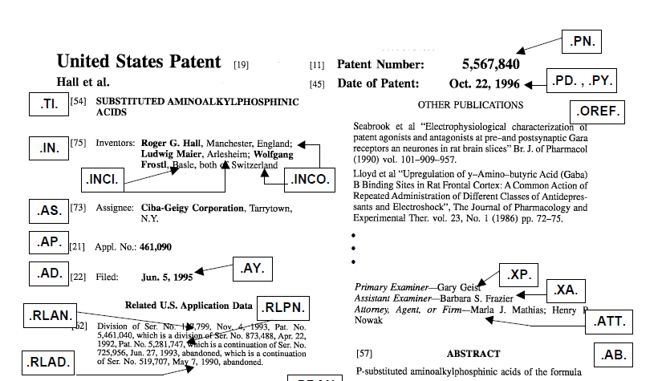
Field Indices

Slide 22
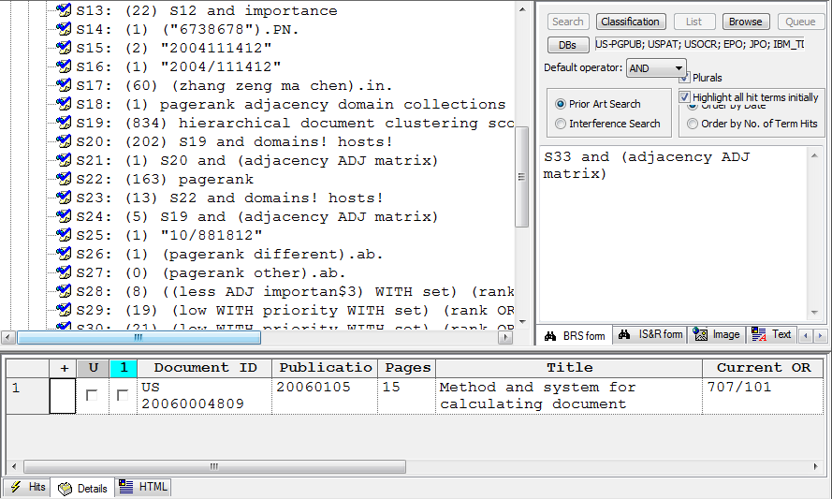
EAST Interface
Notes:
SPE/Examiner's Script: “Here’s an overview of EAST, the search tool I’m going to demonstrate. I’ve highlighted three main areas:
1) The search/preview pane, where I can enter my search strings and preview individual references,
2) The details grid, where the results of my searches are displayed, and
3) The tree view, where my previous searches are stored.”
SPE/Examiner explains how to add databases and toggle plurals in EAST
SPE/Examiner's Script: EAST enables me to simultaneously search all of the databases shown here.

Slide 23
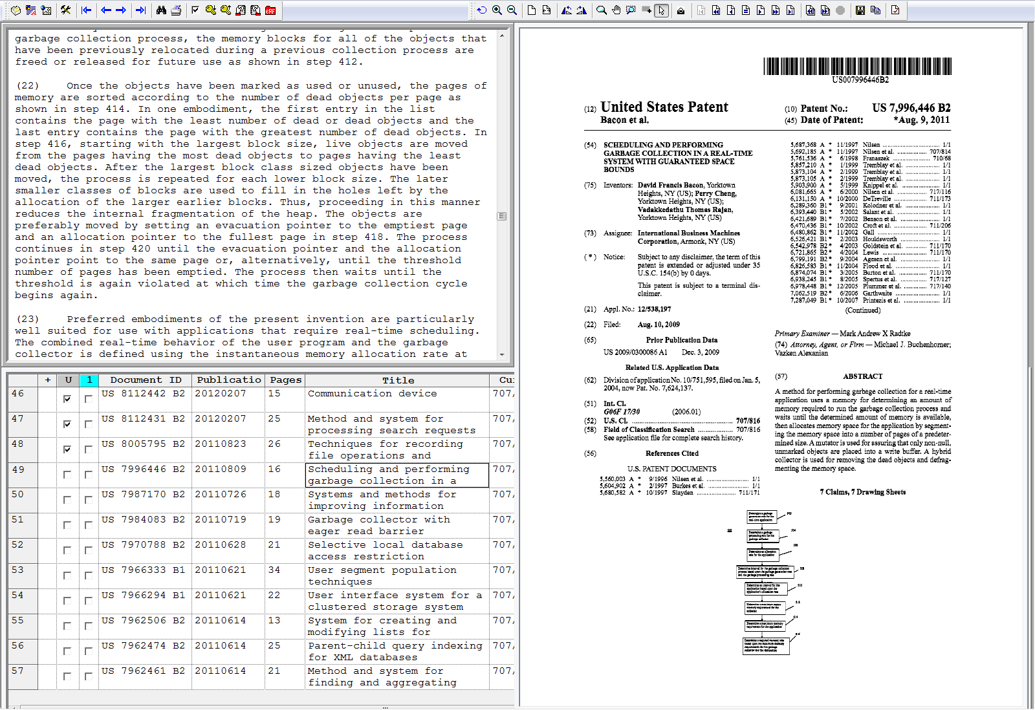
EAST Browser Window

Slide 24
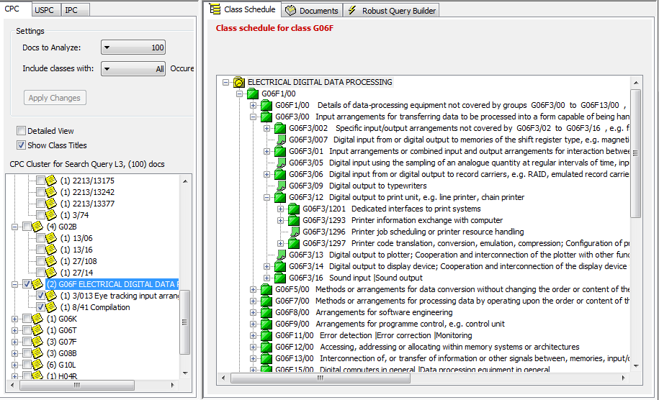
EAST Classification Window

Slide 25
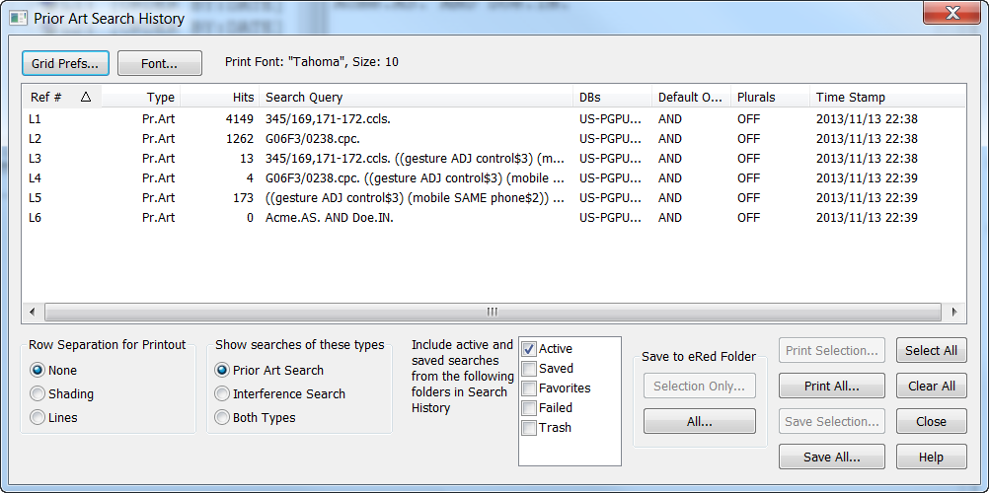
EAST Search History
Notes:
Examiner's Script: Finally, EAST enables me to view my entire search history for this case and save it as a workspace. This workspace will serve as the basis for future searches, such as when I need to search the claim amendments in a few months.

Slide 26
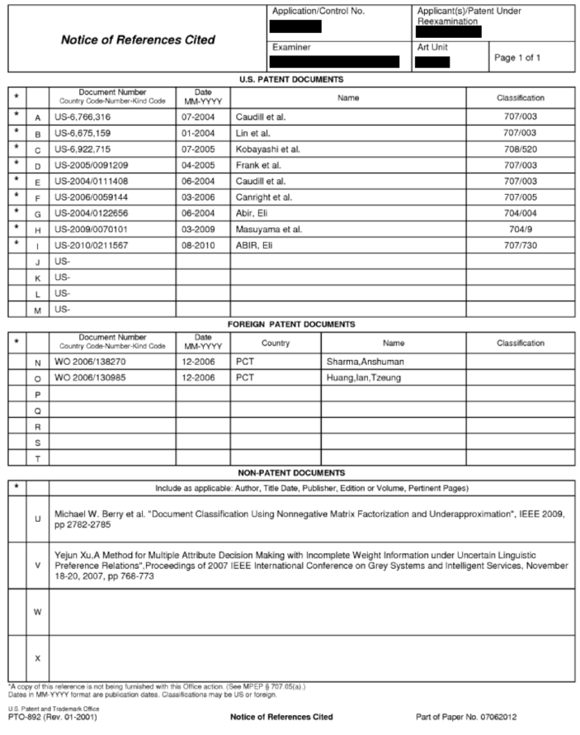
PTO-892
Notes:
Examiner's Script: Finally, EAST enables me to view my entire search history for this case and save it as a workspace. This workspace will serve as the basis for future searches, such as when I need to search the claim amendments in a few months.

Slide 27
Additional Features
Tagging
Backward/forward citations
KWIC (KeyWords In Context)
Derwent patent family view

Slide 28
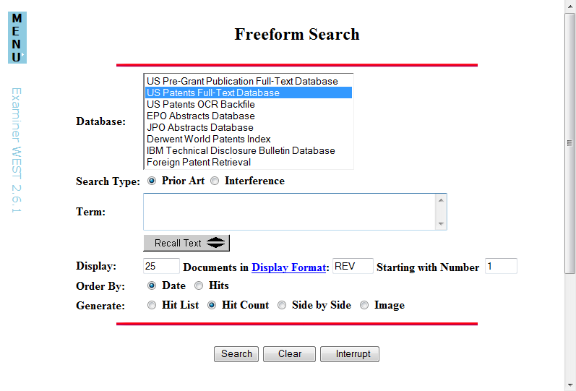
WEST Interface
Notes:
Like EAST, WEST allows for both classification and text searching. WEST uses the familiar Internet Explorer web browser.

Slide 29
Thank you

Slide 30
Collaboration Resources
Scott Beliveau
Supervisory Patent Examiner, TC2400

Slide 31

Introduction
Notes:
With millions and millions of patents and other forms of prior art available – finding prior art is becoming more and more of a team effort that relies on industry/public, global partners, and internal stakeholders. Today, I’m going to talk briefly about some of the external and internal peer collaboration resources available to examiners to help them more efficiently locate/access and understand the growing body of prior art.

Slide 32
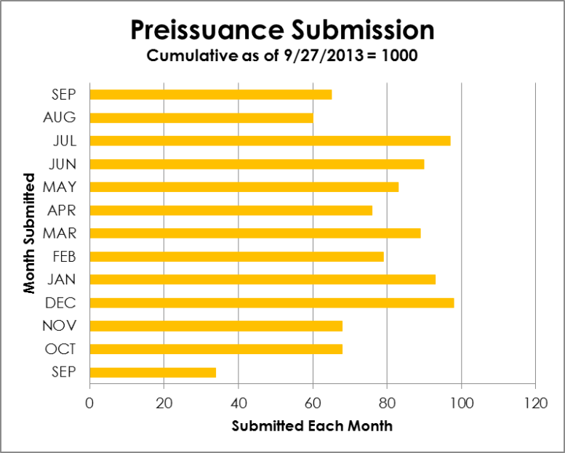
Preissuance Submissions
America Invents Act (AIA) allows the innovation community to contribute to the quality of examination by submitting published materials within a certain timeframe with a concise description of each document’s relevance
More information can be found at:
http://www.uspto.gov/aia_implementation/patents.jsp#heading-7
http://www.uspto.gov/news/pr/2012/12-60.jsp
Notes:
It’s a challenge to find all the relevant prior art for software related applications - much of prior art is in the form of previously written software code which is difficult to find and software code is hard to understand if you didn’t write it. AIA passage made this easier . . . now 3rd parties are able to contribute.
35 U.S.C. 122(e) provides a mechanism for third parties to submit patents, published patent applications, or other printed publications of potential relevance to the examination of a patent application with a concise description of the asserted relevance of each document submitted. Under 35 U.S.C. 122(e), such submissions may be made before (1) the later of (i) 6 months after the date of publication or (ii) the date of a first Office action on the merits rejecting any claims, or (2) before the date of a notice of allowance, if earlier. Section 122(e) also provides for such fees as the Director may prescribe. This new provision is effective September 16, 2012, and will apply to any patent application.
See http://www.uspto.gov/aia_implementation/statistics.jsp for up to date stats and chart for Preissuance submissions

Slide 33
International Worksharing
International agreements allow the USPTO to access work performed by other IP offices to reduce duplication of efforts
Programs include:
Patent Prosecution Highway (PPH)
JP-First
First-Look Application Sharing (FLASH)
UKIPO Worksharing Initiative
USPTO-KIPO Bilateral pilot
Notes:
Another collaborative program . . . . often similar/same applications are filled in multiple countries simultaneously.

Slide 34
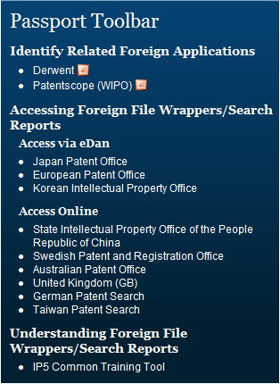
International Worksharing
Examiners are
Made aware that international work results are available
Given direct access to results
Provided with resources to understand the results
More information can be found at:
http://www.uspto.gov/ip/global/patents/ir_pat_worksharing.jsp
http://www.uspto.gov/ip/global/patents/Worksharing.pdf

Slide 35
Publicly-Supported Training
Patent Examiner Technical Training Program (PETTP)
Site Experience Education Program (SEE)
Annual Technology Center Tech Fairs
More information can be found at:
http://www.uspto.gov/patents/pettp.jsp
Notes:
Information received is only as good as you understand what you are looking at – in addition to our internal training programs the USPTO has a number of vendor outreach training programs.
PETTP -- Volunteer scientists and experts lecture examiners on technical developments, the state of the art, emerging trends, maturing technologies, and recent innovations. SEE -- Allows examiners to visit off-campus sites to learn about new technology and experience how technologies operate in the fields. Examiners receive hands-on training specific to their technology
TechFair -- Full-day events where invited speakers from industry present information on cutting-edge technologies

Slide 36

Quality Enhancement Meetings
Peer-centered meetings for examiners of all experience levels to meet, discuss patent applications, and share knowledge
Examiners provide search and examination guidance to their peers
Notes:
Internally a number of resources are available to allow examiners to collaborate with one another . . . one such way is QEMs are offered in some Technology Centers for both on-campus and hoteling examiners.
Identify opportunities for training

Slide 37

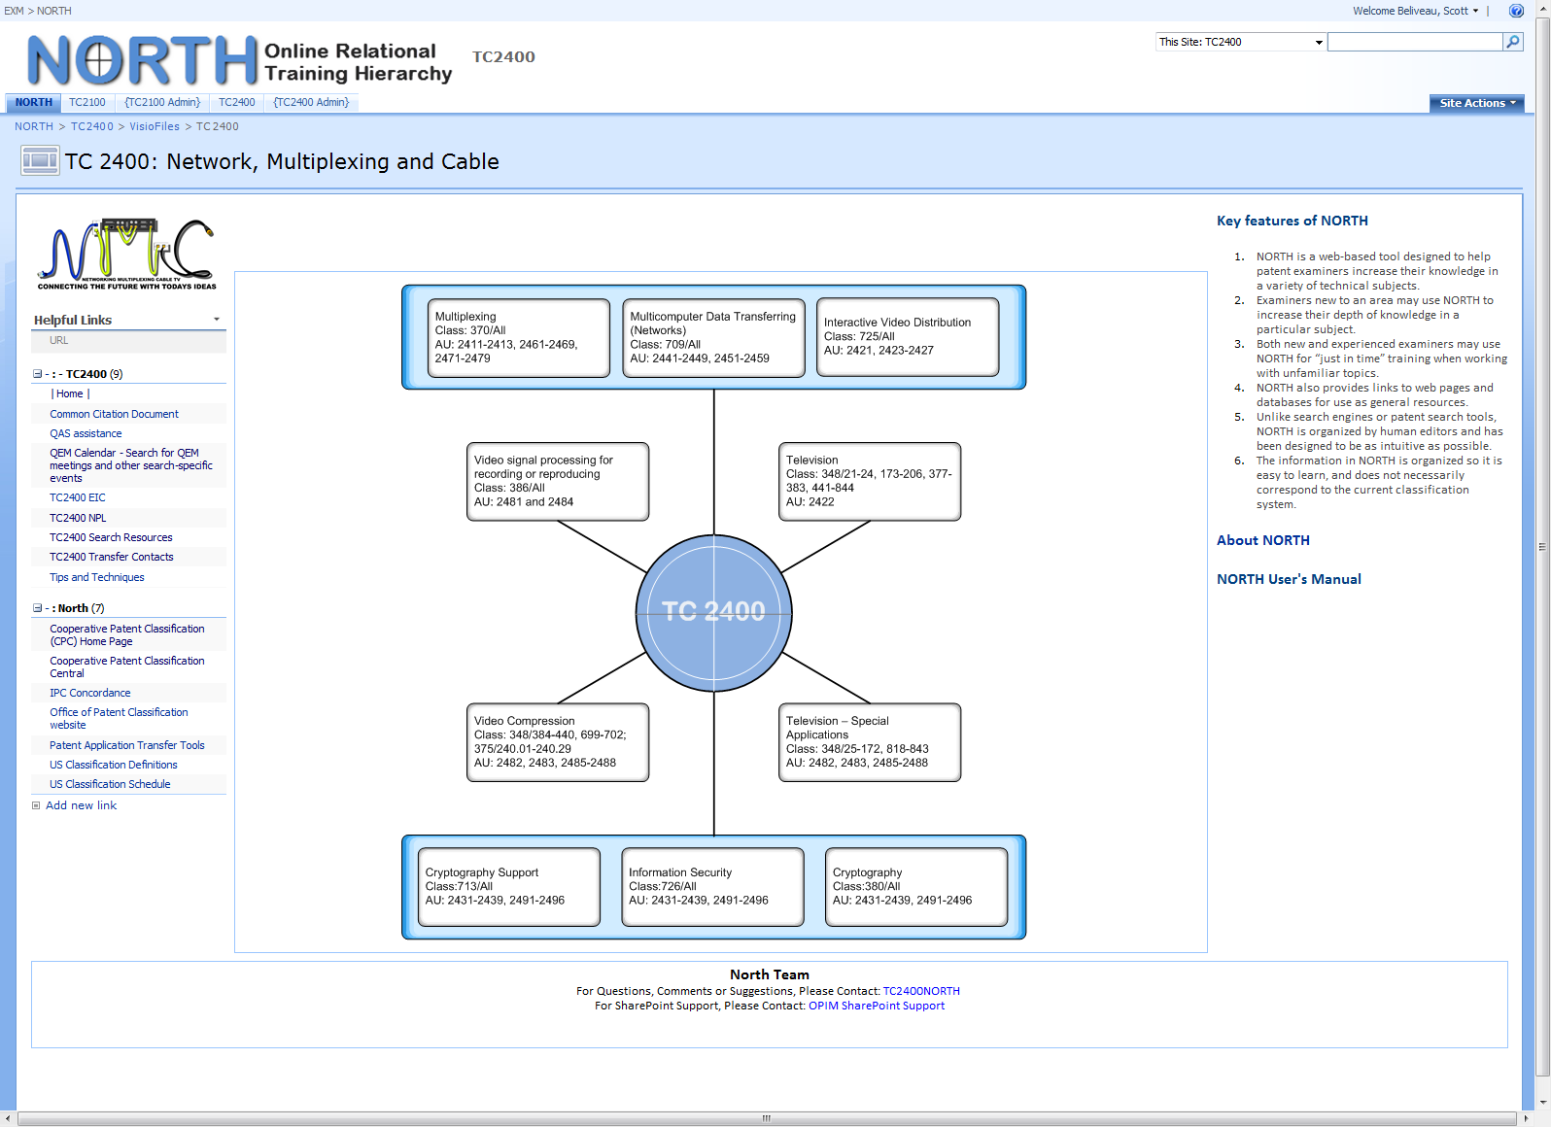
Notes:
SharePoint™-based tool that provides just-in-time technical training on software topics
Examiner-maintainable repository of references and training materials for each art area
Statistical listings of frequently-cited patents arranged by class/subclass
Search Assistant contact information
Calendar of Quality Enhancement Meetings
Tools for examiners to share search strategies, synonyms, and keywords on specific topics

Slide 38
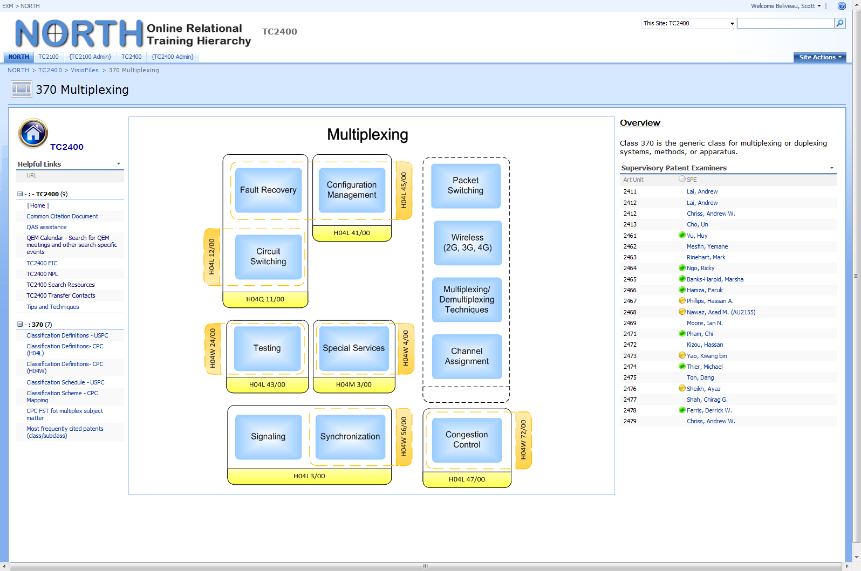

Slide 39
Examiner's Electronic Digest Database (E2D2)
Contains over 13,000 records across all TCs
Database design intended to make it easy for examiners to use
Art- and class-specific keywords
Examiner annotations
U.S. class/subclass information
Resources available include
Book excerpts
Catalogs
Handbooks
Manuals
Journal articles
Technical reports
Translated foreign patents
Newspaper articles
Notes:
Preissuance submissions and international worksharing agreements allows for a fuller more exhaustive set of materials to review.
Publically assisted training programs help examiners better understand the materials provided.
Qem and north provides direct peer assistance in prior art understood by and previously relied upon by others.

Slide 40
Thank you

Slide 41
Scientific and Technical Information Center (STIC)
Pamela Reynolds
Technical Information Specialist, TC2100 & TC2400

Slide 42

STIC
Electronic Information Centers (EICs) are located within each TC
Each EIC houses an art-specific print collection
Main STIC houses a collection of scientific and technical literature
Over 80 million foreign patents
Notes:
Each Technology Center has an Electronic Information Center (EIC) devoted to the Examiners’ prior art needs based on its particular technology.
The collection of prior art includes print and electronic resources for Non Patent Literature (NPL).
In addition to NPL, STIC has over 80 million foreign patents from 60 countries.

Slide 43

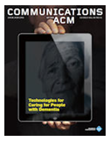
USPTO Collections
500+ databases
59,000+ electronic journals
175,000+ ebooks
Extensive historical and current print collection of books, journals, industry standards, and foreign patents
Notes:
STIC provides access to over 500 databases, 59,000 electronic journal titles, and 175,000 electronic books.
The collection also includes paper editions of technical manuals, textbooks, standards, and reference books.

Slide 44
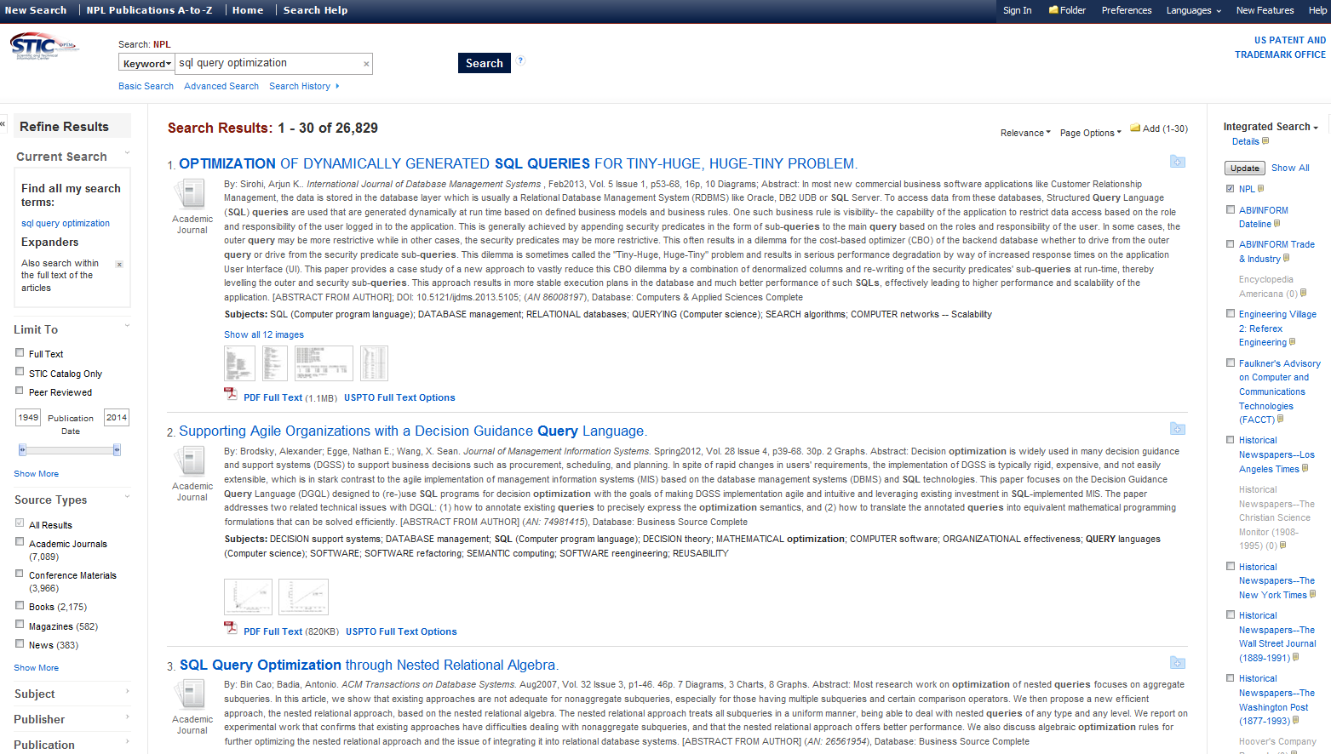
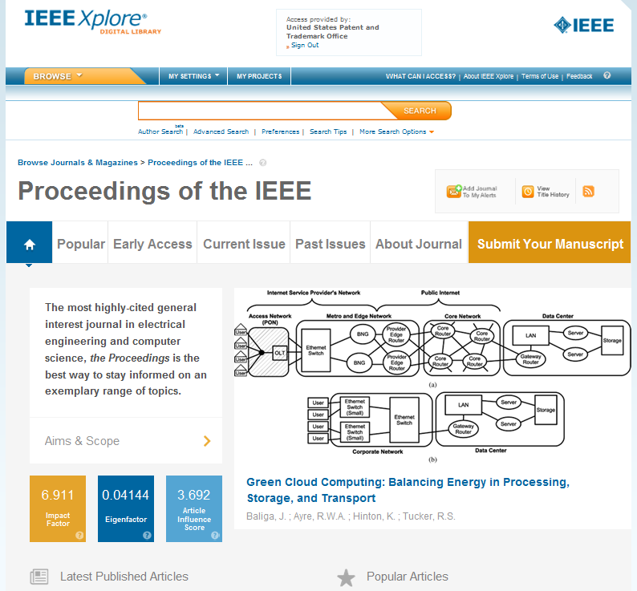

IP-Authenticated Access for Examiners
IEEE Xplore
ACM Digital Library
Inspec
Ei Compendex
Dissertation Abstracts
Research Disclosure
IP.com
Safari Books
Science Citation Index
MathSciNet
ProQuest
EBSCO
ScienceDirect
Notes:
These are several of the databases available to the Examiners via the STIC NPL web page. I am sure you are familiar with many of them, such as IEEE, ACM, IP.com and Inspec.
STIC also provides a discovery tool that allows examiners to search many of these resources simultaneously.

Slide 45
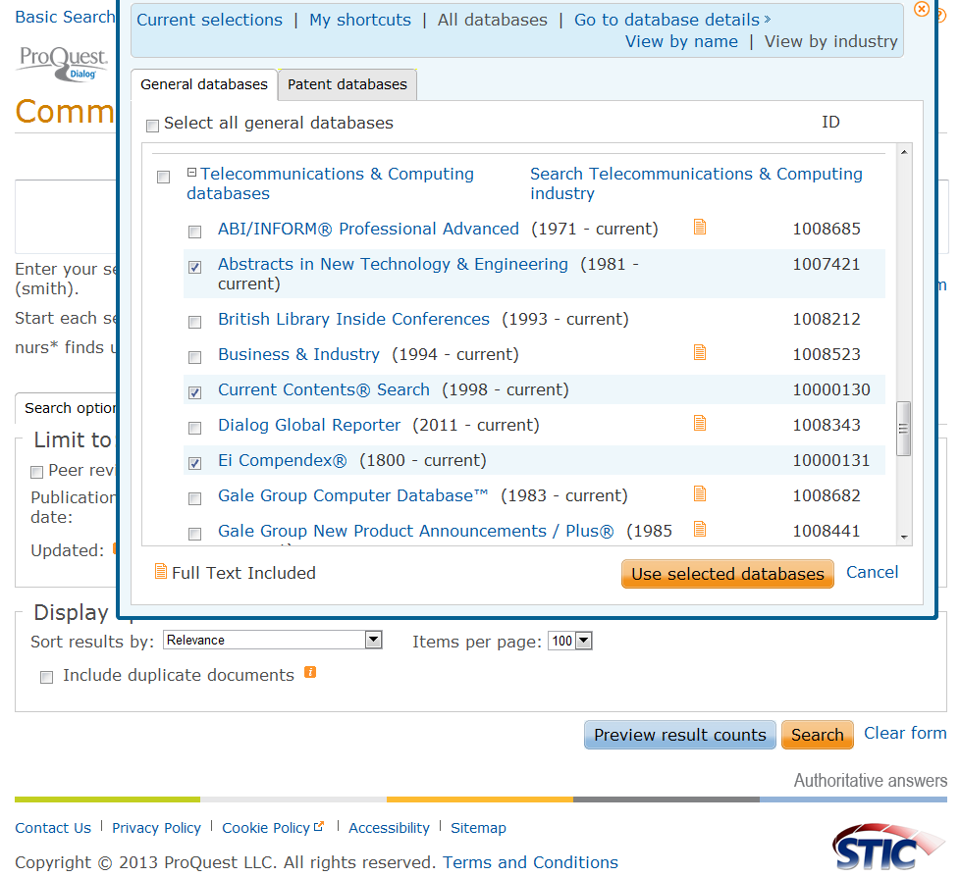
Commercial Databases
ProQuest Dialog
STN
Questel
Lexis/Nexis
Westlaw
Notes:
In addition to the resources listed on the NPL web page, STIC provides access to Proquest-Dialog, STN, Questel, Lexis/Nexis and Westlaw.
These resources require a password, id and training, and some of them are searched only by STIC searchers on behalf of examiners.

Slide 46
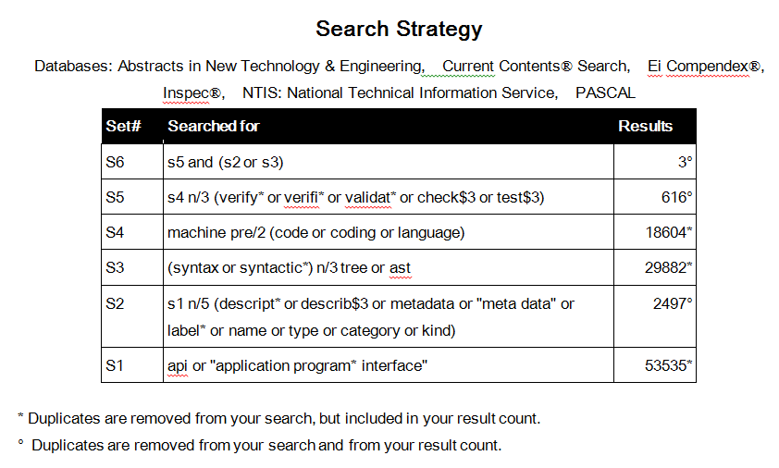

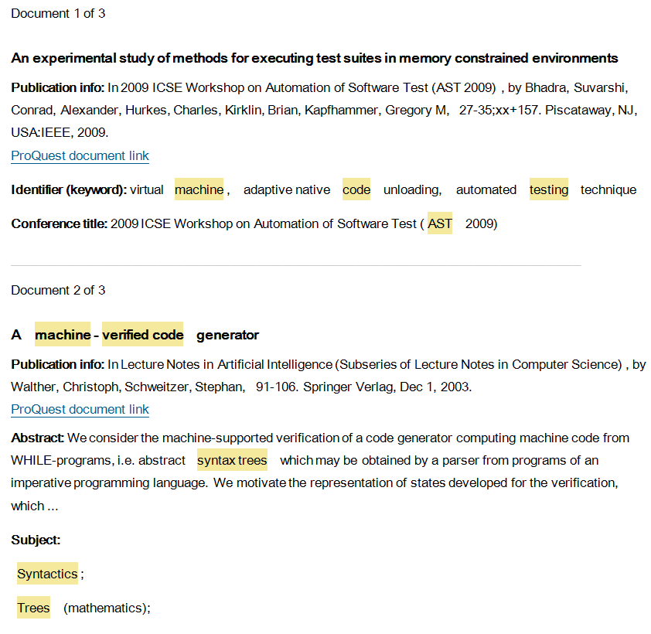
Prior Art Search Services
Professional search staff located in each TC search commercial databases to complement examiners’ searching
Training provided to examiners
PTA
15-Minute Demos
Lunch & Learn Sessions
One-on-one sessions with Search Strategy Experts (SSEs)
Notes:
The EICs also provide prior art search services and training to the Examiners.
After they have done extensive searching themselves, the Examiner may request that a search be conducted by an EIC Searcher.
STIC teaches several classes to new examiners in the Patent Training Academy, covering the topics of NPL Searching, Foreign Patents, and good search practices.
The training is an ongoing service. After Examiners leave the Patent Training Academy, they can attend 15-minute refresher demonstrations and Lunch-and-Learn presentations on topics such as how to use their desktop tools, searching EAST, and searching NPL databases.
One-on-one sessions are also available via an appointment with Search Strategy Experts.

Slide 47
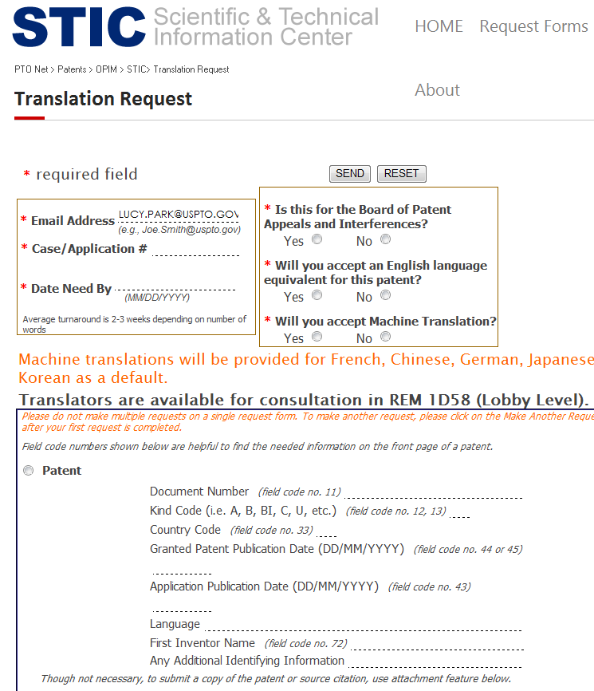
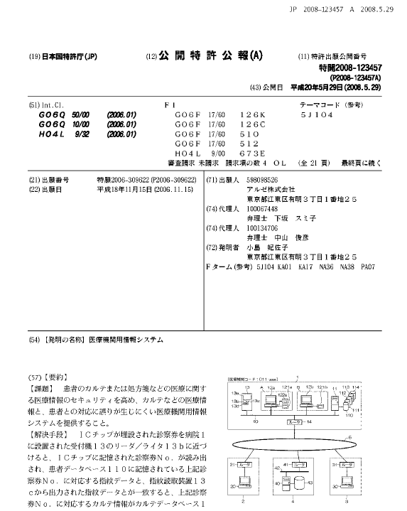
Translation Services
In-house translators
25 languages
Machine translations
External translation services for additional languages
Notes:
In addition to providing access to prior art and document retrieval services, STIC provides a translation service for foreign language documents. STIC has translators who are adept in 25 foreign languages, and also provides access to machine translation tools.

Slide 48
STIC Service Report
FY2013 | TC2100 | TC2400 | Total
Number of Searches Completed | 859 | 1,150 | 2,009
Patent Family Searches | 114 | 186 | 300
Document Delivery Requests | 312 | 139 | 331
Translations (machine, written, oral) | 290 | 331 | 621
STIC Classes/Demos/Training – Examiner Attendees | 4,189 | 4,125 | 8,314
One-on-one Examiner Assistance | 5,197 | 5,976 | 11,173
Notes:
STIC tracks the number of service interactions for each Technology Center.

Slide 49
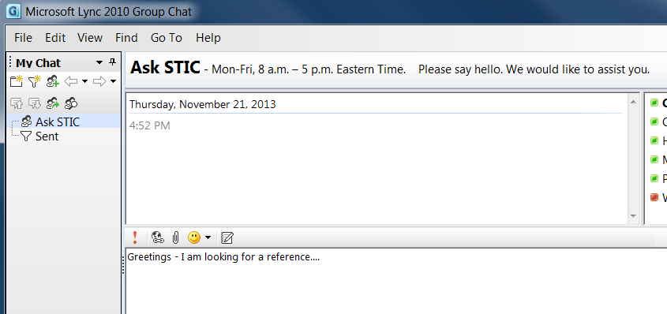
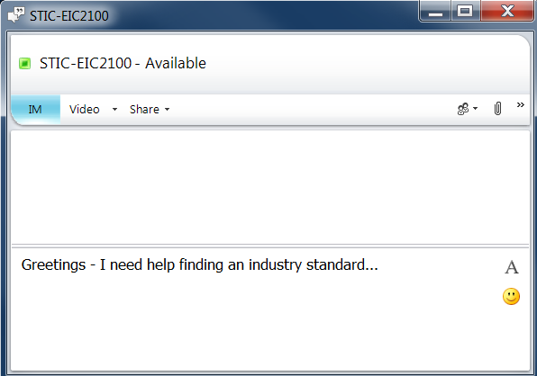
STIC-Examiner Interactions
In-person
Telephone
E-mail
Instant message
Chat room
Notes:
Examiners can contact STIC via chat room or instant messaging as well as email, telephone, and in-person.

Slide 50
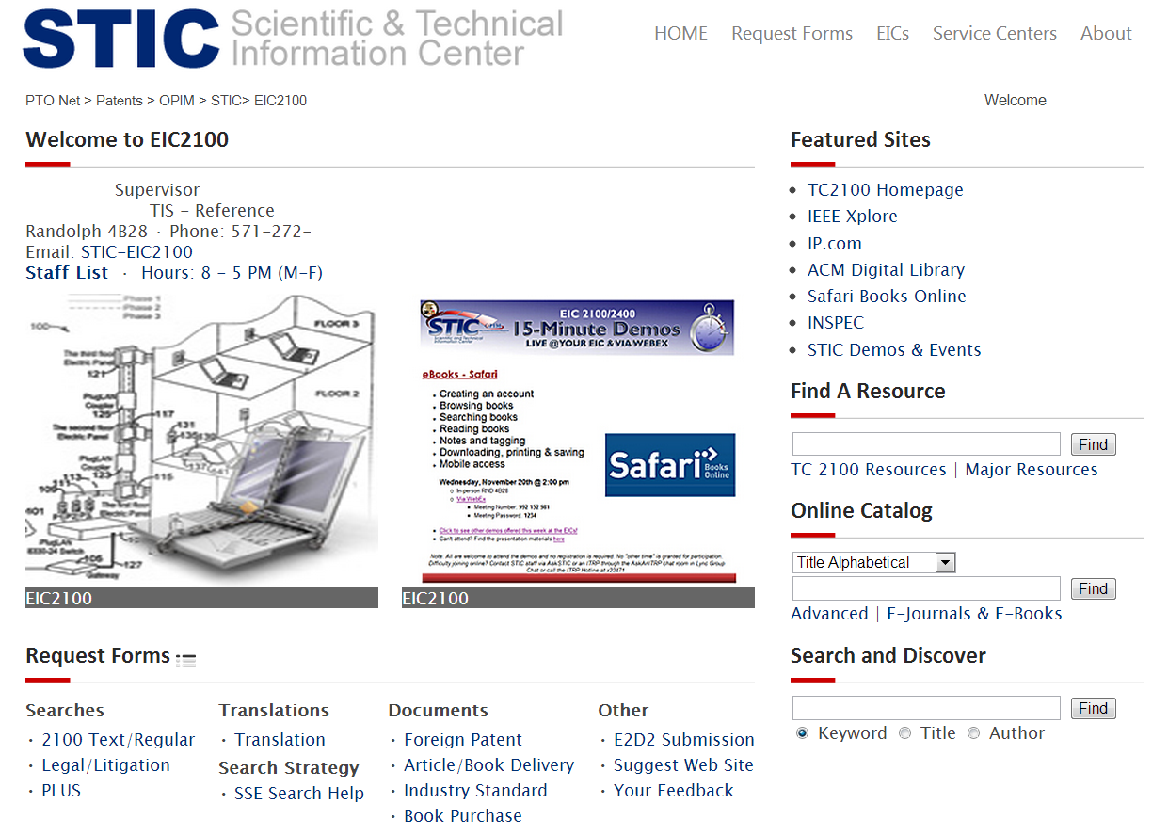
STIC NPL Page
Notes:
Many of the services and resources I mentioned today are available to Examiners via the STIC NPL web page, which is pictured here.
STIC services and resources are available to all examiners, whether they work on campus in Alexandria, at one of the office’s satellite locations, or from home.
Now that we have discussed the various PTO tools for searching, SPE XYZ will demonstrate how a search comes together in practice.

Slide 51
Thank you

Slide 52
Search Demonstration
Boris Pesin
Supervisory Patent Examiner, TC 2100
Notes:
SPE/Examiner from the Software Arts will conduct a demo of the search tools utilizing a sample claim.

Slide 53
Example Claim
A method executed in a mobile device for providing a user interface for an Internet service, comprising:
displaying a web site on the mobile device;
storing web site visit history on the mobile device;
detecting an input to the mobile device; and
based on the input, displaying a web site on the mobile device according to the visit history.
Notes:
Examiner's Script: “But before I start searching I need to understand the scope of the claimed invention. Here’s an example claim to consider. It looks like a software-related invention running on a mobile phone. The invention uses a combination of a user’s input gestures and browsing history to enable a user to navigate a Web site on the mobile phone. I can use this understanding to develop a search plan as follows.”

Slide 54
Demo
Notes:
Read specification, drawings, and claims
Draw claim diagram/tree
Identify relevant classes
Select relevant search terms
Synonyms/related concepts
Search strategy/strings

Slide 55
Q&A

Slide 56
Thank You
Jim Dwyer | Janet Gongola
Chirag Shah | Mark Radtke
Brian Sircus | Gail Hayes
Anne Hendrickson | Boris Pesin
Scott Beliveau | Alexander Kalinowski
Stephen Koziol | Mohammad Ghayour
Karen Catlin | Nathan Newhouse
Ginger DeMille | Lucy Park
Vei-Chung Liang | Pamela Reynolds

Slide 57
Break

Slide 58
Stakeholder Presentations

Slide 59
Brad Pedersen
Patent Practice Chair
Patterson Thuente IP
Telephone: 612-349-5774
pedersen@ptslaw.com

Slide 60


Automated Snapshot Capture
Pilot Project Proposal for Improving
Captured NPL Prior Art for Software Applications
USPTO Software Partnership Meeting
Brad D. Pedersen
December 5, 2013
© 2013 Patterson Thuente Pedersen, P.A., May be distributed with attribution - www.ptslaw.com
DISCLAIMER: This presentation and any information contained herein are intended for educational and informational purposes only and should not be construed as legal advice.

Slide 61
The First NPL Problem Undated Web Postings Cannot be Relied Upon
MPEP 2128
Date of Availability
Prior art disclosures on the Internet or on an on-line database are considered to be publicly available as of the date the item was publicly posted. * > Absent evidence of the date that the disclosure was publicly posted, if < the publication > itself < does not include a publication date (or retrieval date), it cannot be relied upon as prior art under 35 U.S.C. 102(a) or (b)*>. However <, it may be relied upon to provide evidence regarding the state of the art. Examiners may ask the Scientific and Technical Information Center to find the earliest date of publication > or posting <.

Slide 62



The Second NPL Problem The Illusive and Ever-Changing World-Wide Web
Internet Archive
Does not crawl websites that “opt out” with “robots.txt”
Knowledge Bases
Wikipedia: freely changeable
Knowledge Graph and Freebase: social/historical focus
Semantic Web
Great idea that remains mostly unrealized
Deep Web
Harvesting below the surface web is a hard problem
2-3 orders of magnitude more information than surface web
BrightPlanet.com

Slide 63
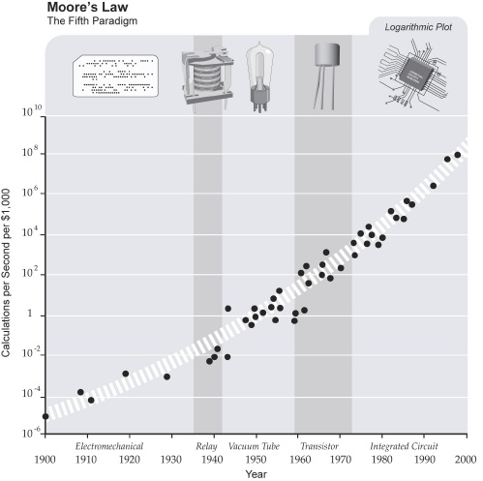
The Underlying NPL Problem The Exponential Increase of Information
The Amount of Stored Information has Exploded
“Every two days now we create as much information as we did from the dawn of civilization up until 2003”, according to Eric Schmidt in August 2010.
That was something like five exabytes of data in 2010.
By 2016, Internet traffic will be more than a zetabyte (10²⁰)
Exponential Increase is the Rule, Not the Exception

Slide 64
The Snapshot Proposal Creating Time-Anchored Searchable Silos of NPL
Automated Ingesting of Patent Application
Pilot limited to Specific Art Groups for Software cases.
“Opt In” by completing Electronic Form
Search targets generated by claim key-wording, glossification, NLP analysis of specification and optional image analysis of figures
Possible tuple creation for semantic search using OWL, rdf, XML and future cognitive computing analysis (Watson)
Search/Crawl as of Filing Date of Application
Search targets used to capture specific NPL sources as of filing date
Wikipedia/Freebase/Knowledge Graph/Wolfram Alpha
IEEE/ACM/EFF blogs, RFCs
Inventor/Assignee web materials
Limited set of results from ranked search/harvest of entire web

Slide 65
The Snapshot Proposal Creating Time-Anchored Searchable Silos of NPL
“Opt In” Electronic Form Includes:
Suggested search classes/sub-classes for application
Expressly defined terms
Structure/steps for each means-plus-function claim element
Initial List of IDS references
Optional claim set with corresponding reference numerals
Searchable Silo of Results stored in Private PAIR
Copyrighted material not accessible other than to applicant
Incentives for Participating
Examiners given extra time in prosecution to analyze captured silos
Applicants could be given advancement in queue of pending cases
Applicants get bibliography of NPL that reduces add’l IDS filings

Slide 66
The Snapshot Proposal Expanded Claim Key-Wording
Use Expanded Claim Sets for Key Word Frequency
Utilize the inherent nature of independent and dependent claims to improve key word frequency scores.
1. A hat for an animal, comprising:
a shell;
a harness arrangement attached directly to the hat, including a first strap and a second strap, wherein the first strap and the second strap each have two loose ends which are movably secured to the shell of the hat; and
the first strap and the second strap cross each other at a point below the muzzle of the animal when the hat is secured.
2. The hat of claim 1 wherein at least one of the first strap and the second strap is of a resilient material.
Vs.
1. A hat for an animal, comprising:
a shell;
a harness arrangement attached directly to the hat, including a first strap and a second strap, wherein the first strap and the second strap each have two loose ends which are movably secured to the shell of the hat; and
the first strap and the second strap cross each other at a point below the muzzle of the animal when the hat is secured.
2. A hat for an animal, comprising:
a shell;
a harness arrangement attached directly to the hat, including a first strap and a second strap, wherein the first strap and the second strap each have two loose ends which are movably secured to the shell of the hat; and
the first strap and the second strap cross each other at a point below the muzzle of the animal when the hat is secured;
wherein at least one of the first strap and the second strap is of a resilient material.
+

Slide 67
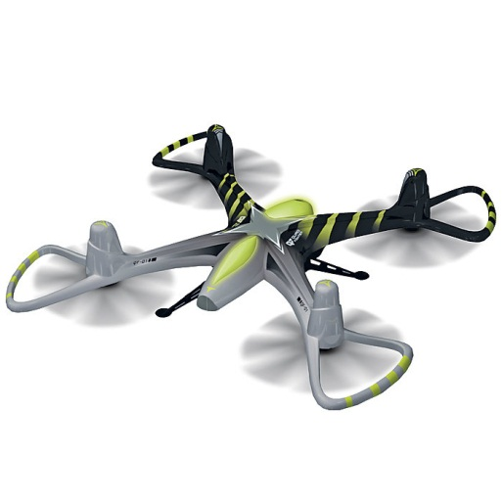

Thank You!
About Brad Pedersen
Brad Pedersen is a patent attorney with more than 25 years of experience in patent law, engineering, business and entrepreneurship. He is a partner and the chair of the Patent Practice group at Patterson Thuente Pedersen, P.A., an intellectual property law firm in Minneapolis, Minnesota.
Brad is also a successful inventor and entrepreneur, with more than a dozen issued US patents and a recently launched RC gaming drone company – QFO Labs, Inc.
Brad is one of the more knowledgeable IP attorneys in the U.S. when it comes to the patent reform and the AIA. Since it was first introduced in 2005, he has actively followed the developments and debate surrounding patent reform at the agency, legislative and judicial levels. He educates clients and colleagues by writing and presenting on the imminent changes and strategies for dealing with the reforms.
Brad can be reached at pedersen@ptslaw.com or (612) 349.5774
About Patterson Thuente IP
Patterson Thuente Pedersen, P.A. helps creative and inventive clients worldwide protect, and profit from, their ideas. Practicing in the areas of patents, trademark, copyright, trade secrets, IP litigation, international IP protection, licensing and post-grant proceedings, the firm’s attorneys excel at finding strategic solutions to complex intellectual property matters.
Visit us online at www.ptslaw.com.

Slide 68
John Toebes
Senior Director, Cisco Systems
Patent effectiveness tools and Process Telephone: 919-476-2041 toebes@cisco.com

Slide 69
Identifying Related Patents Through Tags and Categories
John Toebes
Senior Director, Intellectual Property
November 5, 2013

Slide 70
Background
Identifying good prior art requires great searching
Tough to scale without experts
Similar to recommendation systems such as collaborative filtering
Companies such as Amazon figured out how to scale this problem
Cisco has > 10,000 Issued US patents with an internal tool called CPOL which provides search capabilities
Cisco applied tags and categories to successfully improve the ability to locate assets

Slide 71
Addressing the Issue
Created Category Taxonomy to cover all assets
Tested the taxonomy with different people
Not dissimilar from CPC, but with important restrictions
Only three level, ~200 categories
Each category must expect to represent no less than 1% and no more than 5% of all assets
Each patent asset can have no more than 3 categories.
Scarcity and bucket size ensure that assets will at least be in the bucket everyone looks in

Slide 72
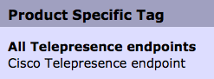
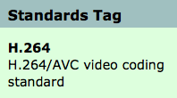
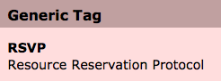
User Tags
While categories ensure that you will have the asset in the collection, tags allow for refinement.
Tags are user defined but have types: Products, Standards and Generic
Tags also include a description and identify the creator
Anyone can create a tag and apply any tag to any patent asset
Tag management tools allow for combining, marking equivalence and even retiring tags.

Slide 73
Tag Validation
There is no central authority for tagging
With any set of patent assets, a tag cloud quickly tells you what it is about
With only 10% of our assets tagged, we could readily distinguish our portfolios
At 90% coverage it becomes easy to see outliers
Clusters of related patents become easy to recognize

Slide 74
Refining Search
When looking for a particular asset, it is easy to start with a category even though it brings a large set.
Turning on the Tag Cloud gives instant visibility into what else could be looked for
Searching for a combination of tags allows prioritizing the best match
Search Categories ➔ Tag Cloud ➔ Tag Combinations

Slide 75
Surprising Results
It is less important who tagged something or what they tagged it with than the fact that the same person tagged multiple items.
Given any set of found patents, you can find other similar ones by using the tags on the initial set. The weight of the frequency of the tags allows for prioritization of the matched set
Inventors and even business organizations or assignees can be treated as virtual tags to improve the match

Slide 77
Dominic DeMarco On behalf of PIUG
Managing Director, DeMarco IP, LLC
Telephone: 703-623-4745
demarco@demarcoip.com

Slide 78
Michael Messinger
Director, Sterne, Kessler, Goldstein & Fox P.L.L.C.
Telephone: 202-772-8667
mikem@skgf.com

Slide 79
Incentivizing Applicant-Provided Search Results
Michael V. Messinger
Partner, Electrical and Clean Tech Practice Group

Slide 80
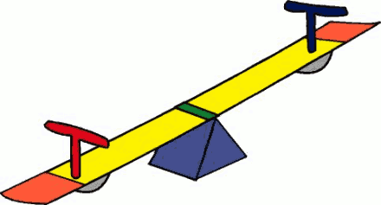
Search or No Search?
Recent Software Patent Trends Favor Search
“File Without Search” Approach is Becoming Harder to Justify
Search Costs Down
Risks of Willful Infringement and Inequitable Conduct From Proper Search Down
Increased Scrutiny by PTO and Courts of Software Patents Under
§§ 101, 112, 102 and 103
Advantages to Knowing Best Prior Art

Slide 81
Significant Incentives For High-Quality Searching Are Already Present
Software Patent Marketplace Benefits
Patent grant over quality prior art increases software-related patent valuation
IDS filings can increase patent valuation
Presence of respected non-patent literature can increase value
Drafting Benefits
Understanding closest prior art permits tailored claim drafting, range of scope, and more effective claim terminology
Allows better interviewing of inventors
Leads to more detail in specification
Better pre-filing filtering
Examination Benefits
Faster end-to-end prosecution, less RCEs
Helps ensure adequate disclosure under § 112
Helps ensure adequate disclosure to overcome § 101
Helps avoid prior art surprises and eligibility rejections

Slide 82
Advantages of Searching in Software Arts
Drafting | Examination | Valuation
Problem/Solution focus Identifies inventive concepts and meaningful limitations Provides opportunity for inventors to amplify description of inventive concepts Claims overcome prior art Accurate terminology Adequate writtendescription | Shortens prosecution Increases opportunities for Success in overcoming 101, 112, 102 and 103 rejections Alerts Examiner of allowable subject matter | IDS increases valuation Grant over representative prior art increases valuation Tailored claims scope increases valuation Better spending decisions

Slide 83
Possible New Incentives for High-Quality Searching by Applicants
Add a yes/no check box on Application Data Sheet:
If no IDS accompanies this filing, indicate whether a search has been performed.
Increase Proper Application of Rule 105 (MPEP §§ 704.10-11)
Allows Examiners to request information from Applicant
Factors include:
Whether IDS is present
Whether background description is adequate
Limits to what can be requested: “Similar to 37 CFR 1.56, applicant is required by 37 CFR 1.105 to submit information already known, but there is no requirement to search for information that is unknown.” MPEP § 714.12

Slide 84
Possible New Incentives for High-Quality Searching
Add an indication on face of patent indicating items of information provided by Applicant
Add an indication on face of published patent applications indicating items of information provided by Applicant
Add a yes/no check box in Office Action cover sheet of whether Examiner found information in Applicant’s IDS or Background helpful.
Publish results by assignee, inventor, and legal representative name.
Provide rewards to Applicant for including a high-quality search for software-related art
Non-Patent Literature
Descriptions of relevance
Strong background section
Potential rewards
Reduce or waive search fees
Advance examination

Slide 85
Possible New Incentives for High-Quality Searching
New Technical Tools to facilitate IDS Submission
Accept video information in IDSs

Slide 86
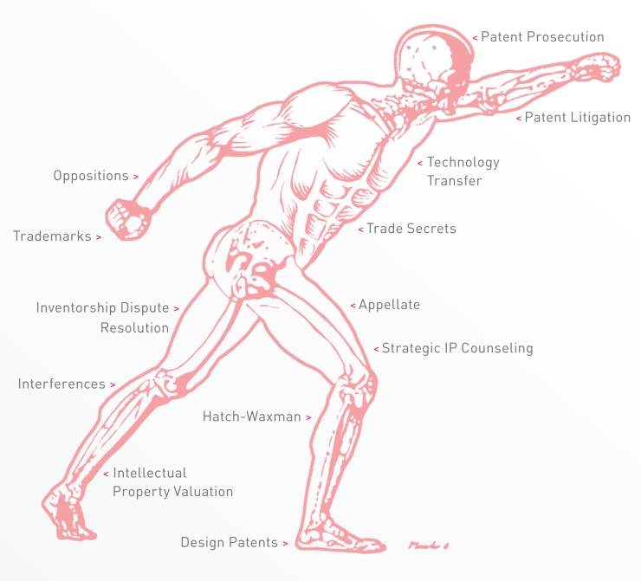
Contact Information
Mike Messinger
mikem@skgf.com
202.772.8667
1781697

Slide 87
Discussion

Slide 88
Next Steps
Evaluate the information collected
Generate recommendations for examiners and stakeholders
Training
Tools
Continue the dialogue through
Microsite
Future partnership events

Slide 89
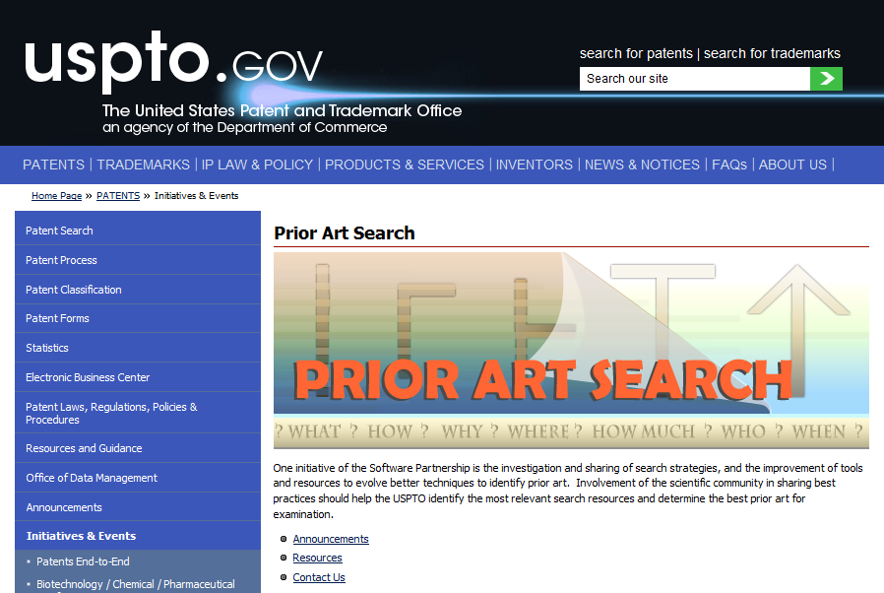
Prior Art Micro-Site

Slide 90
Thank You!
Seema S. Rao
Technology Center Group Director, TC 2100
Seema.Rao@uspto.gov
(571) 272-5253

